Slide 1
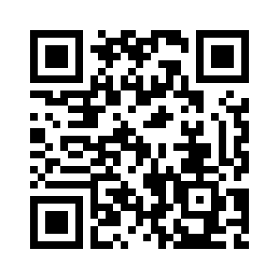
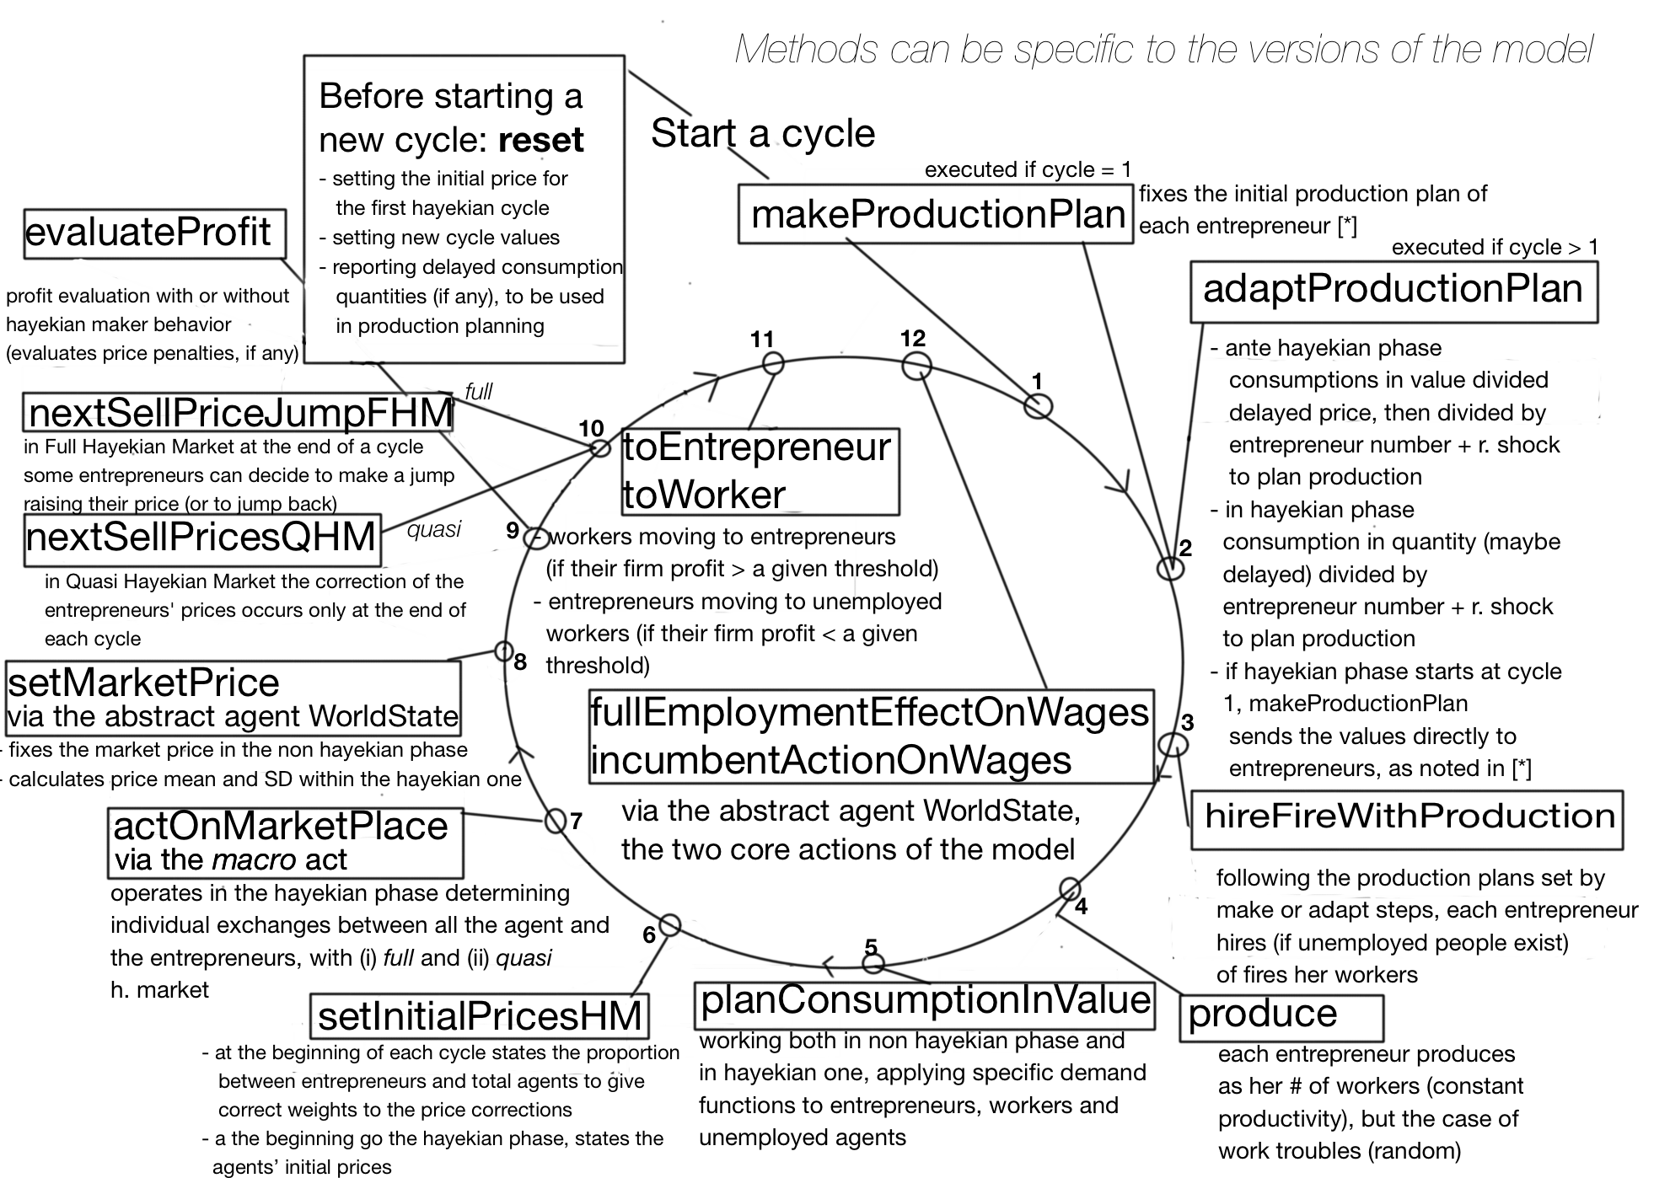
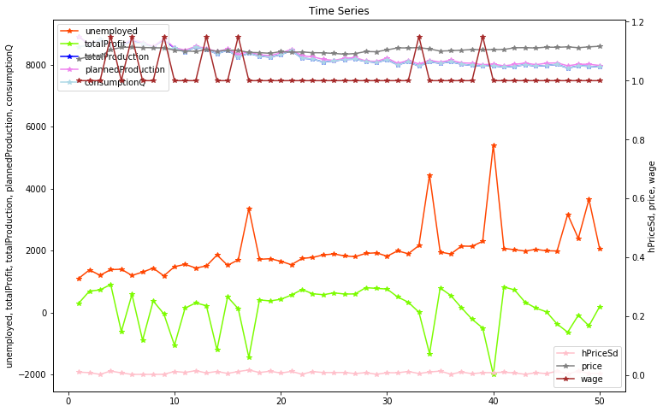
Oligopoly
Rethinking macroeconomics with endogenous market structure
Marco Mazzoli, Matteo Morini, Pietro Terna (September 2018)
Formal model at:
https://terna.github.io/oligopoly/
Agent-based model:

